Slide 1




AI ePORTFOLIO Research interest: Gaming
COURSE: CSC 570- ARTIFICIAL INTELLIGENCE
INSTRUCTOR: DR. OSUNMAKINDE ISAAC
BY: PAUL TENKORANG

Slide 2

A Ghanaian. MSc. Computer Science (NSU).
2 truths 1 lie
I love watching soccer.
I have two kids.
I have been to 4 other countries aside my home country.

Slide 3
TABLE OF CONTENTS
INTRODUCTION
CHATBOT
EXPERT SYSTEM
SIMPLE REFLEX AGENT
KNN (CLASSIFIER, REGRESSOR AND MULTI LINEAR REGRESSOR)
UNINFORMED SEARCH (BFS AND DFS)
NATURAL LANGUAGE PROCESSING
SENTIMENT ANALYSIS
CONCLUSION
GAME PLAYING

Slide 4


INTRODUCTION
Embark on a journey through my ePortfolio, where I unveil the fusion of Artificial Intelligence and gaming.
Witness how this convergence elevates player experiences and pushes the boundaries of AI capabilities.
Join me in exploring the uncharted territories where innovation meets imagination, reshaping the future of digital entertainment.

Slide 5
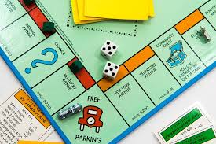
VOICE ASSISTANT FOR MONOPOLY GAME RULES
Monopoly, a game centered on property and wealth accumulation, entails complex gameplay rules for victory.
Players often find reading and understanding these rules time-consuming and tedious.
A proposed solution involves creating a voice assistant dedicated to Monopoly, providing instant access to specific rules during gameplay.
This assistant not only offers comprehensive knowledge but also facilitates direct communication with customer service for additional inquiries or concerns, enhancing the gaming experience.
Task Description

Slide 6
VOICE ASSISTANT FOR MONOPOLY GAME RULES
Demonstration

Slide 7

GAME PREDICTOR: A MODEL BASED EXPERT SYSTEM
In an area with limited gaming exposure, a pioneering game center has surfaced, but inexperienced patrons struggle to select suitable games upon arrival.
The system assists novices by collecting preferences and offering personalized game recommendations considering age group, genre, participants, gaming platform, and parental controls for children.
The system's goal is to enhance the customer experience by simplifying game selection, reducing concerns, and uncertainties about participating in the gaming center's activities.
The system aims to help the establishment by providing tailored game suggestions, boosting newcomers' confidence in exploring the gaming center's offerings.
Task Description

Slide 8
GAME PREDICTOR: A MODEL BASED EXPERT SYSTEM
Simplifies game selection for patrons with limited gaming exposure, offering a personalized experience based on their preferences.
Tailors game suggestions by prompting users to input their age, preferred game genre, number of players, gaming platform, and need for parental control.
Encourages repeat visits by delivering a positive, hassle-free experience.
Satisfied customers are likely to return and recommend the establishment to others, potentially generating positive word-of-mouth referrals.
How it works

Slide 9
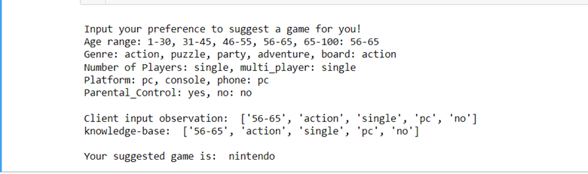
GAME PREDICTOR: A MODEL BASED EXPERT SYSTEM
Demonstration
An image showing the user inputting their preferences, followed by the system recommending a Nintendo game.

Slide 10
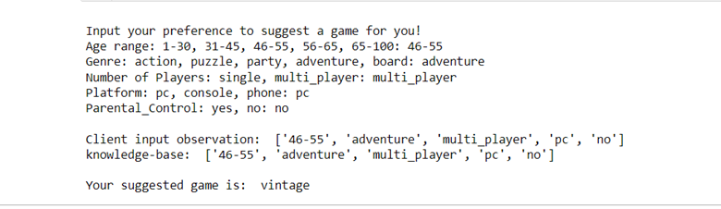
GAME PREDICTOR: A MODEL BASED EXPERT SYSTEM
Demonstration
An image showing the user inputting their preferences, followed by the system recommending a Vintage game.

Slide 11
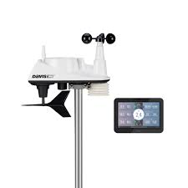
TempGuard Pro: A SIMPLE REFLEX AGENT
A game console manufacturing company encountered a critical challenge during testing: certain consoles exhibited performance issues under prolonged exposure to specific temperature conditions.
To tackle this challenge, the company devised an inventive remedy—an advanced cooling system powered by a simple reflex agent program.
This cooling system aims to regulate temperature fluctuations within the consoles, addressing potential performance problems triggered by prolonged exposure to specific temperature conditions.
The implementation of this innovative cooling solution showcases the company's dedication to providing gamers with uninterrupted, exceptional gaming experiences.
Task Description

Slide 12
TempGuard Pro: A SIMPLE REFLEX AGENT
The system continuously monitors the console's internal temperature through embedded sensors, swiftly detecting fluctuations.
When temperatures exceed safe limits, the reflex agent program activates the console's cooling mechanism, such as a fan, to reduce temperature levels promptly.
The system maintains optimal temperature ranges by activating and deactivating the cooling mechanism as needed, ensuring efficient cooling without excessive cooling.
Through its proactive approach, the system aims to prevent overheating-related performance problems, safeguarding console performance and extending its lifespan for an uninterrupted gaming experience.
How it works

Slide 13
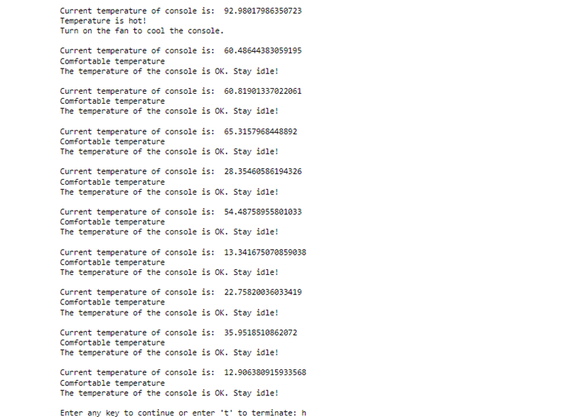
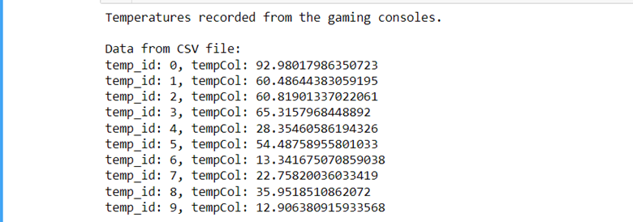
TempGuard Pro: A SIMPLE REFLEX AGENT
This image shows the decisions made after reading the temperature values from the consoles.
Demonstration
This image shows the temperature values recorded from the consoles.

Slide 14
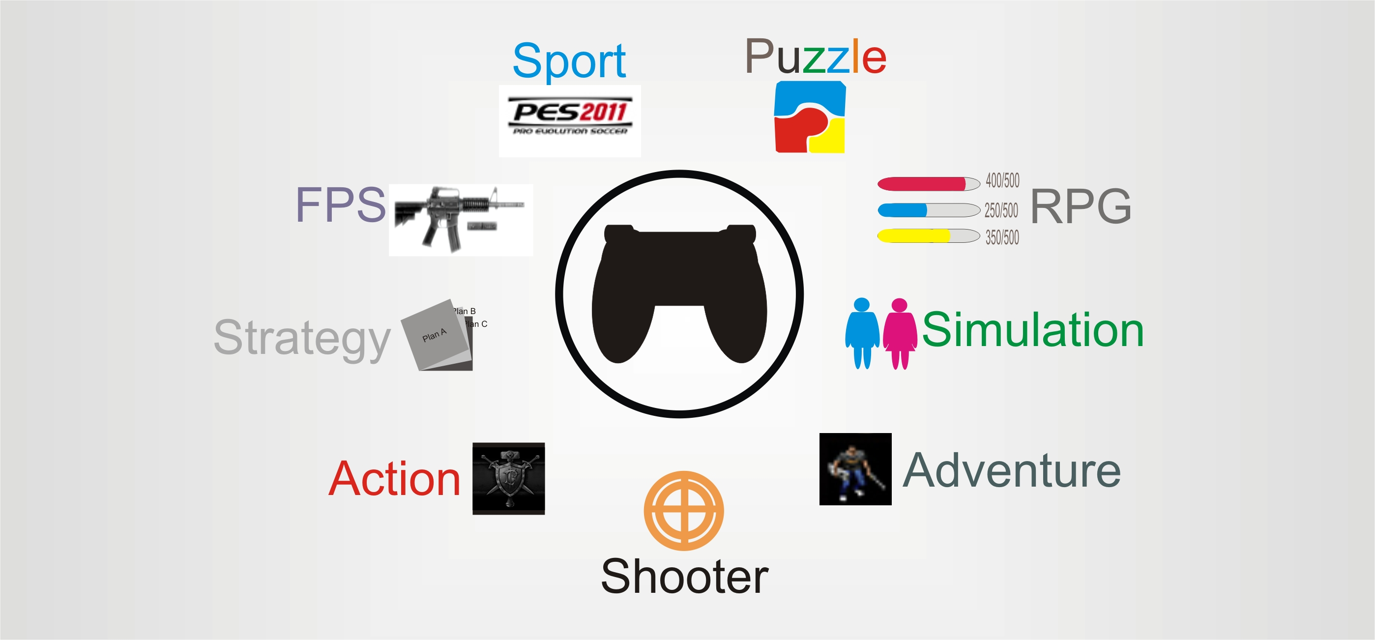
GenreGain Insight: MODEL-BASED RECOMMENDER AGENT
The gaming wholesale industry player aims to boost their game sales investments by identifying the most lucrative game genres. They possess data on game publishers and annual sales across different genres.
With a limited budget, the company intends to strategically allocate funds towards game genres that promise higher sales and profitability.
To address this challenge effectively, the company is seeking the development of a predictive system. This system will leverage available financial resources and preferred publishing partners to make informed decisions regarding game genre investments.
The goal is to utilize this predictive system to guide investment decisions intelligently, ensuring that the allocated budget is efficiently utilized to maximize sales and profitability in collaboration with selected game publishers and genres.
Task Description

Slide 15
GenreGain Insight: MODEL-BASED RECOMMENDER AGENT
Users input their preferences, specifying the preferred game publisher and the total investment budget.
Based on the user's preferences, the system filters the dataset to identify game genres from the specified publisher within the allocated budget.
It iterates through the dataset, summing global sales of different game genres until the budget limit is reached.
The system then suggests profitable game genres that fit within the defined budget and the publisher's catalog.
How it works

Slide 16
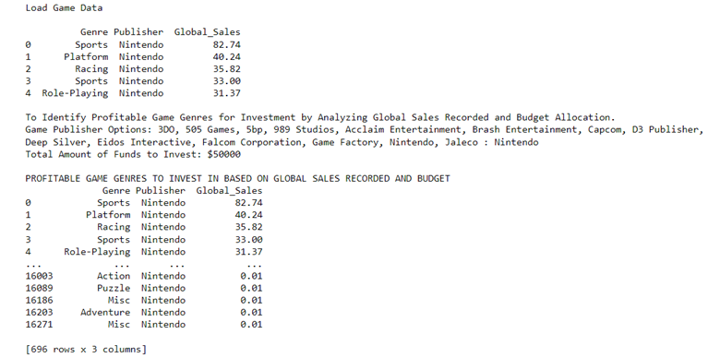
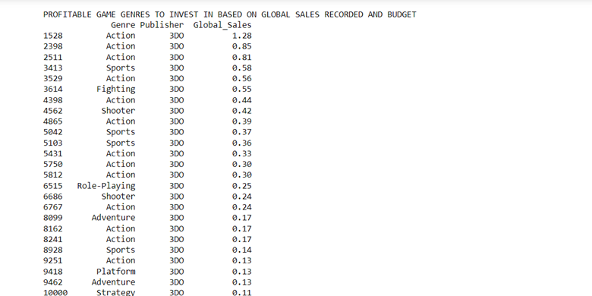
GenreGain Insight: MODEL-BASED RECOMMENDER AGENT
Demonstration
This image shows the predicted game genres as the user input Nintendo as the publisher and $50000 as the budget to invest.
This image shows the predicted game genres as the user input 3DO as the publisher and $100000 as the budget to invest

Slide 17
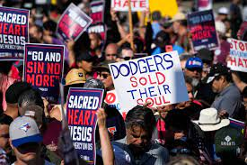
Protest Predictor: LEARNING AGENT WITH KNN CLASSIFIER
Recent NFL games have witnessed player and team protests addressing issues of racial inequality and police brutality.
These demonstrations have sparked significant controversy, prompting the NFL to implement various policies in response to these protests.
By this, historical data related to protests during NFL games is being analyzed using the K-Nearest Neighbors (KNN) approach. The dataset includes details such as the year of the game, previous match scores, reasons for protests, and the total number of arrests during the game.
The goal is to predict the likelihood of a protest occurring during an NFL game using this historical data.
Task Description

Slide 18
Protest Predictor: LEARNING AGENT WITH KNN CLASSIFIER
How it works
It examines historical data encompassing game details, prior scores, protest reasons, and arrest counts for the game.
Based on these data, makes predictions as to if there is the likelihood of a protest occurring or not for the next NFL game.
Semi-autonomous functionality providing predictions based on user-provided game parameters.

Slide 19
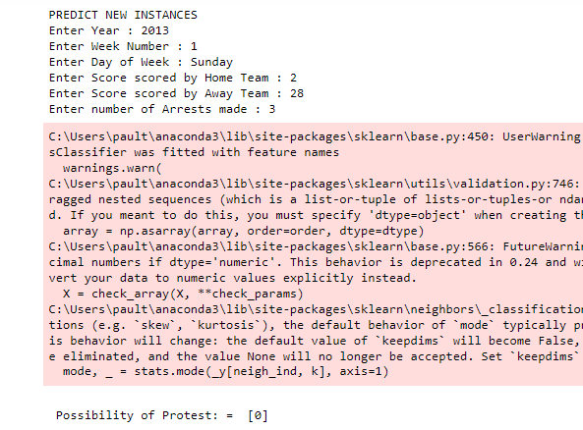
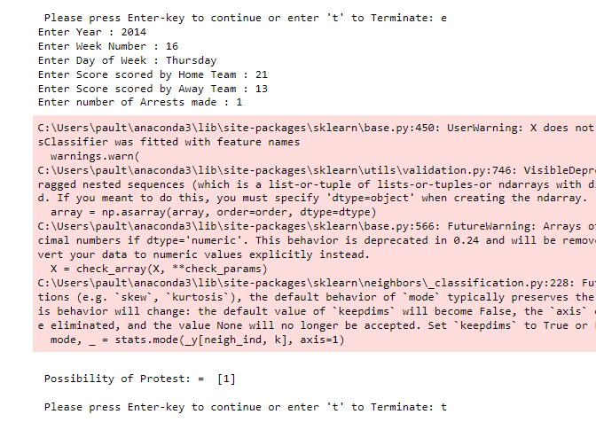
Protest Predictor: LEARNING AGENT WITH KNN CLASSIFIER
Demonstration
An image showing a predicted instance of [0] after taking in inputs from the user. This means there is not a likelihood of protest happening that day.
An image showing a predicted instance of [1] after taking in inputs from the user. This means there is a likelihood of protest happening that day.

Slide 20
Protest Predictor: LEARNING AGENT WITH KNN CLASSIFIER
Demonstration
A writeup explaining how the system works.

Slide 21

Sales Predictor: LEARNING AGENT WITH KNN REGRESSOR
Video game sales analysis involves collecting and analyzing video game sales data to understand market trends and consumer behavior.
Essential for professionals in the video game industry, aiding decisions in game development and marketing strategies.
Developed a K-Nearest Neighbors (KNN) model using global game sales data to predict sales potential for specific video game genres.
Exhibits intelligence and operates semi-autonomously, advancing comprehension of video game sales dynamics..
Task Description

Slide 22
Sales Predictor: LEARNING AGENT WITH KNN REGRESSOR
How it works
Leverages the dataset's depth across various platforms, genres, and regions to gain insights into elements contributing to a game's success.
The system predicts global sales potential for a specific video game genre based on user-provided inputs of Genre, Year, and sales figures across regions.
Make informed decisions, and creating successful games aligned with consumer preferences.

Slide 23
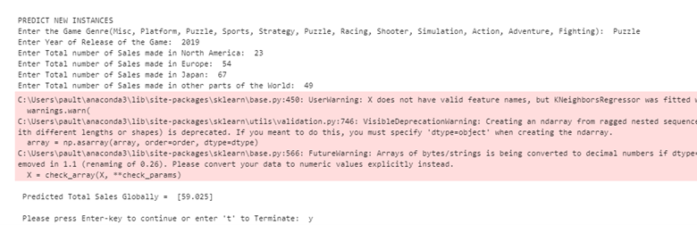
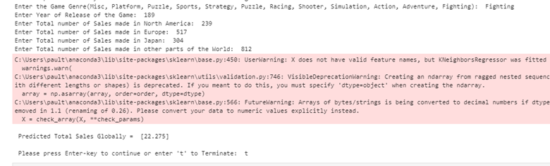
Sales Predictor: LEARNING AGENT WITH KNN REGRESSOR
Demonstration
An image showing a predicted instance of [59.025] after taking in inputs from the user. This shows the predicted Global sales of the game genre Puzzles is 59.025.
An image showing a predicted instance of [22.275] after taking in inputs from the user. This shows the predicted Global sales of the game genre Fighting is 22.275.

Slide 24
Sales Predictor: LEARNING AGENT WITH KNN REGRESSOR
Demonstration
A writeup explaining how the system works.

Slide 25
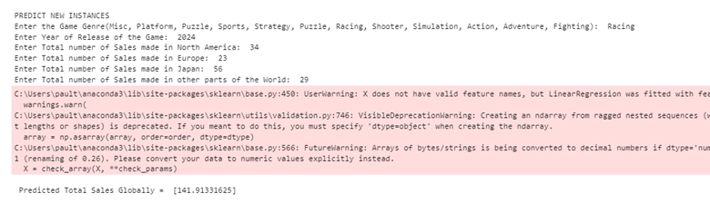
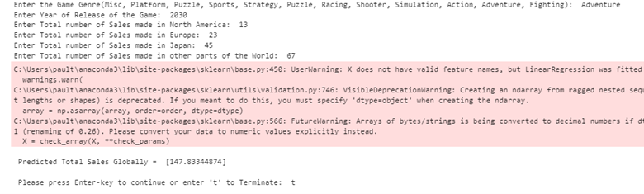
Sales Predictor: LEARNING AGENT WITH MULTI LINEAR REGRESSOR
Demonstration
An image showing a predicted instance of [141.913] after taking in inputs from the user. This shows the predicted Global sales of the game genre Racing is 141.913.
An image showing a predicted instance of [147.833] after taking in inputs from the user. This shows the predicted Global sales of the game genre Adventure is 147.833.

Slide 26
Sales Predictor: LEARNING AGENT WITH MULTI LINEAR REGRESSOR
Demonstration
A writeup explaining how the system works

Slide 27
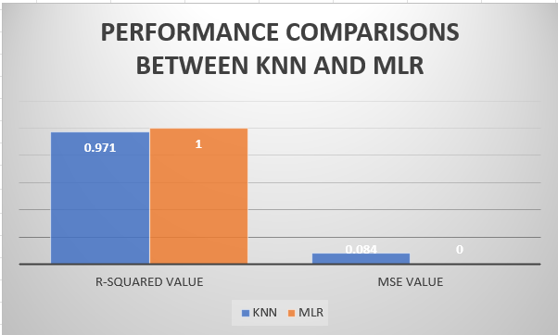
COMPARISONS BETWEEN KNN AND MLR
Higher R-squared values indicate better model fit. Therefore, the MLR model better fits this dataset better than the KNN model and by this its higher R-squared value.

Slide 28

ConsoleWatch Pro: UNINFORMED SEARCH STRATEGIES
A sophisticated casino facility is equipped with multiple gaming rooms, each hosting an array of gaming consoles concurrently.
The casino intends to implement a system for real-time monitoring of the gaming rooms and their consoles to ensure continuous assessment of console processing speed and operational status.
Through Breadth-First Search and Depth-First Search algorithms, a comprehensive framework is developed.
This approach enhances system reliability and aids in maintaining a high-quality gaming experience for patrons by promptly addressing potential issues.
Task Description

Slide 29
ConsoleWatch Pro: UNINFORMED SEARCH STRATEGIES
The system systematically navigates through gaming rooms, pinpointing each console.
It displays real-time data showcasing the current processing speed and operational status of the targeted consoles.
Tracks cumulative operational hours of consoles for timely maintenance interventions, ensuring sustained performance.
This approach enhances system reliability and aids in maintaining a high-quality gaming experience for patrons by promptly addressing potential issues.
How it works

Slide 30
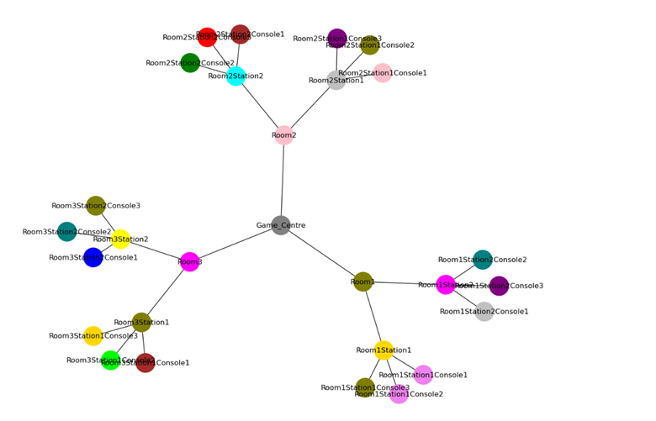
ConsoleWatch Pro: UNINFORMED SEARCH STRATEGIES
Demonstration
An image showing the network graph shown for the search algorithms.

Slide 31
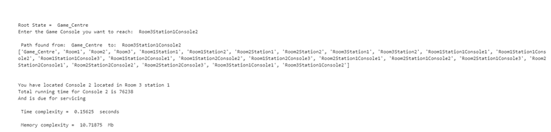
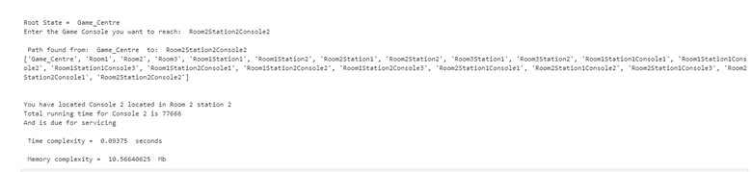
ConsoleWatch Pro: UNINFORMED SEARCH STRATEGIES
Demonstration
Breadth-First Search algorithm traversing through the nodes and locating a consoles. It also displays information about the consoles.

Slide 32
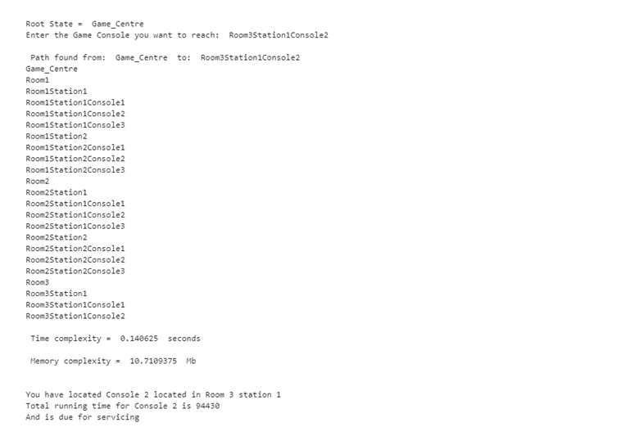
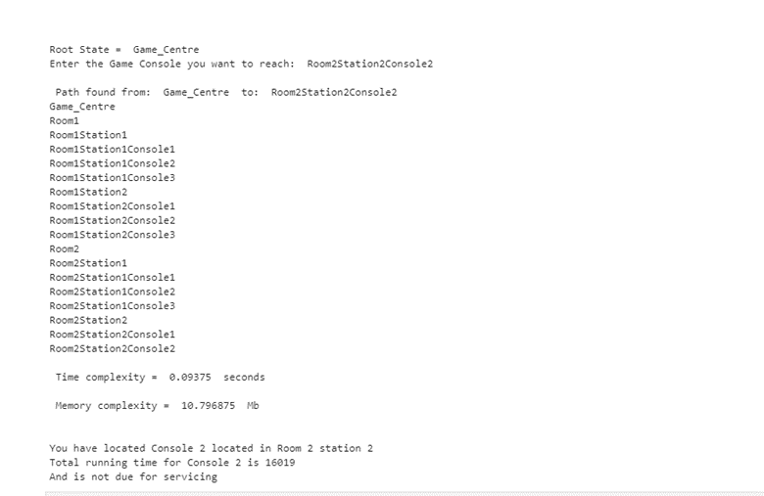
ConsoleWatch Pro: UNINFORMED SEARCH STRATEGIES
Demonstration
Depth-First Search algorithm traversing through the nodes and locating a consoles. It also displays information about the consoles.

Slide 33
ConsoleWatch Pro: UNINFORMED SEARCH STRATEGIES
Demonstration
A writeup explaining how the system works.

Slide 34
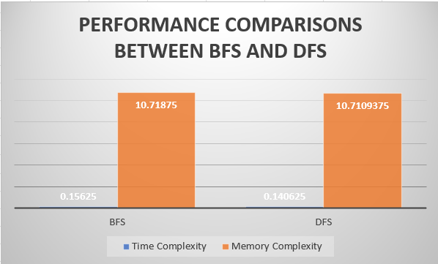
COMPARISONS BETWEEN BFS AND DFS
Observed that both algorithms exhibited fairly similar performance under identical computer and environmental conditions. Differences not significant enough to conclusively establish superiority for one over the other.

Slide 35

Tech Dealership Integrity Analysis: Unveiling the Truth Behind Public Claims through NLP Scrutiny
Task Description
Widespread claims have emerged, alleging that a specific technology dealership, specializing in gaming consoles and various tech gadgets, provides products of inferior quality.
Assigned the role of a Media Investigative Analyst, tasked with the responsibility of examining and scrutinizing these allegations regarding product quality using the information at hand.
The primary focus of the assigned task involves a thorough investigation and assessment of the claims made about the dealership's products, utilizing available information and resources to gather evidence and insights.

Slide 36
Tech Dealership Integrity Analysis: Unveiling the Truth Behind Public Claims through NLP Scrutiny
How it works
My resources include access to the dealership company's website and a textbook routinely provided to their customers, containing detailed information about the products they distribute.
Developed a Natural Language Processing system capable of extracting pertinent details from both the company's website and the textbook.
This system aims to either substantiate the public's assertions or debunk them based on a thorough analysis of the gathered data.

Slide 37
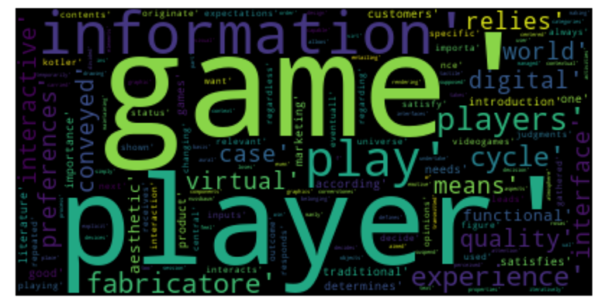
Tech Dealership Integrity Analysis: Unveiling the Truth Behind Public Claims through NLP Scrutiny
Demonstration
A visual analysis of the images generated from the technology dealerships handbook.

Slide 38
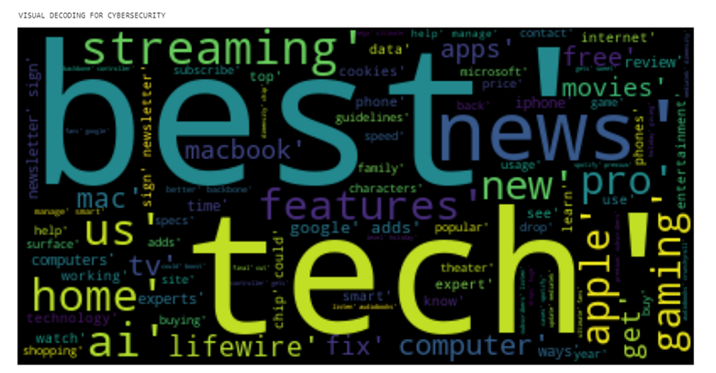
Tech Dealership Integrity Analysis: Unveiling the Truth Behind Public Claims through NLP Scrutiny
Demonstration
A visual analysis of the images generated from the technology dealerships website.

Slide 39
Tech Dealership Integrity Analysis: Unveiling the Truth Behind Public Claims through NLP Scrutiny
Demonstration
A writeup explaining how the system works.

Slide 40
Tech Dealership Integrity Analysis: Unveiling the Truth Behind Public Claims through NLP Scrutiny
Interpretation
Examining the word cloud generated from the dealership's webpage indicates positive results, contradicting the claims made by the public. Conversely, the word clouds derived from the company's handbook consistently exhibit a neutral stance, lacking clear indications of either positivity or negativity.
This absence of distinct sentiment makes it challenging to take sides, suggesting a need for more evidence to make an informed judgment

Slide 41

Reddit Gaming Pulse: NLP Sentiment Analysis
Reddit, as a diverse platform for discussions, particularly in gaming, prompts this project's focus on sentiment analysis within the r/gaming subreddit.
Annotated with sentiment labels, over 13,000 comments are the primary data set for analysis.
Leveraging NLP techniques and sentiment analysis algorithms, the project aims to explore emotional nuances in gaming-related conversations.
Key goals include categorizing comments based on sentiments, unveiling shifts in emotional tones, and exploring potential correlations between sentiments and specific gaming themes.
Task Description

Slide 42
Reddit Gaming Pulse: NLP Sentiment Analysis
Reddit, as a diverse platform for discussions, particularly in gaming, prompts this project's focus on sentiment analysis within the r/gaming subreddit.
Annotated with sentiment labels, over 13,000 comments are the primary data set for analysis.
Leveraging NLP techniques and sentiment analysis algorithms, the project aims to explore emotional nuances in gaming-related conversations.
Key goals include categorizing comments based on sentiments, unveiling shifts in emotional tones, and exploring potential correlations between sentiments and specific gaming themes.
How it works

Slide 43
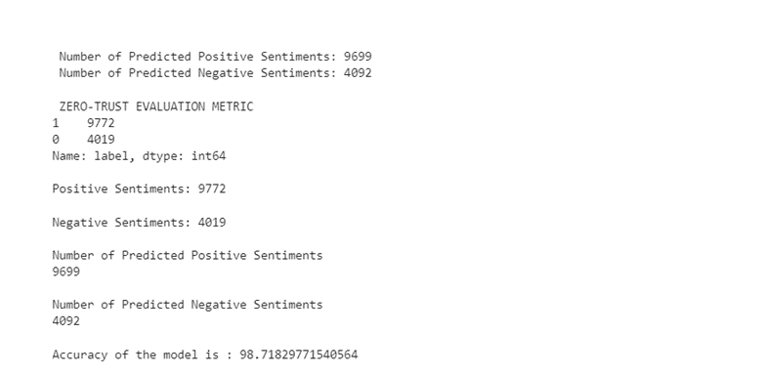
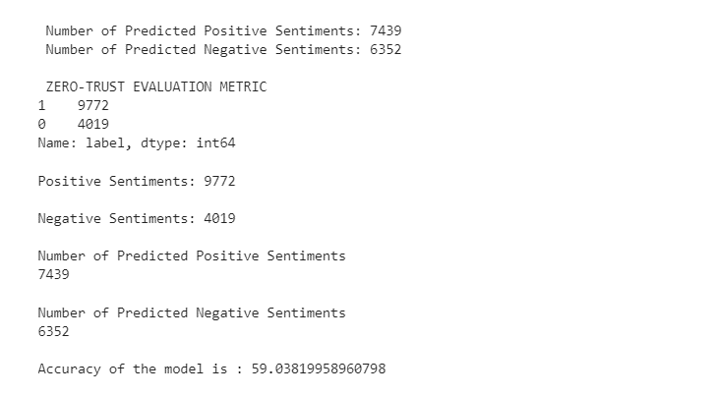
Reddit Gaming Pulse: NLP Sentiment Analysis
Results
Sentiment analysis using Vader shows better accuracy than using TextBlob. The accuracy in Vader is 98.71 while that in TextBlob is 59.04.

Slide 44
Reddit Gaming Pulse: NLP Sentiment Analysis
Interpretation
The accuracy difference between VADER and TextBlob stems from distinct factors related to their design and capabilities.
VADER excels due to its specialized lexicon tailored for social media text, enabling better interpretation of slang, emoticons, and contextual language nuances.
TextBlob, with its generalized lexicon and simpler sentiment analysis mechanism, might be more appropriate for formal language.
Choosing between VADER and TextBlob should depend on specific contextual needs, considering their strengths and weaknesses for accurate sentiment analysis.

Slide 45
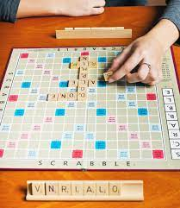
Scrabble Scoring Game: Game playing
Task Description
To encourage healthy competition among colleagues, there is the need to provide a competitive environment where they can challenge each others knowledge.
The game stimulates cognitive abilities by requiring players to recall words, apply spelling rules, and calculate scores based on assigned point values to letters.
The game offers entertainment and enjoyment for players, making the learning process engaging and enjoyable rather than just an academic exercise

Slide 46
Scrabble Scoring Game: Game playing
How it works
The game starts with three players taking turns to input words based on the chosen theme.
The score for the entered words are calculated based on the points associated with each letter in the word according to the game rules.
It compares the scores of the players and determines the winner based on the highest score.
Announces the winner!

Slide 47
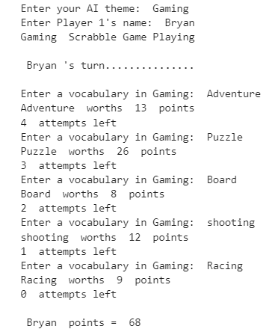
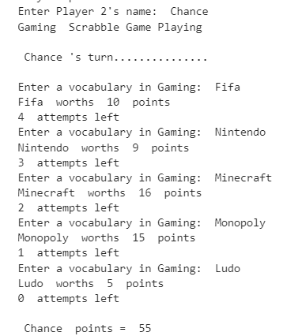
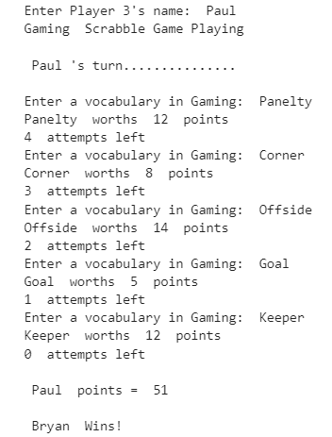
Scrabble Scoring Game: Game playing
Results

Slide 48
FUTURE WORK
Implementing AI to enhance immersion, interactivity, and realism in AR/VR gaming environments, such as more lifelike NPCs, smarter interactions, and enhanced environmental responses.

Slide 49

CONCLUSION
This ePortfolio offers a comprehensive dive into the multifaceted world of gaming, showcasing its impact on game development, player experiences, and interactive entertainment.
The insights gained speak volumes about the symbiotic relationship between human creativity and AI's computational power, fostering an environment ripe for groundbreaking advancements.

Slide 50

APPRECIATION
My heartfelt gratitude to Professor Isaac Osunmakinde for your unwavering support and encouragement.
You have played an instrumental role in shaping my academic journey particularly in my exploration of infusing AI and gaming.

Slide 51
THANK YOU!
QUESTIONS?

